Slide 1

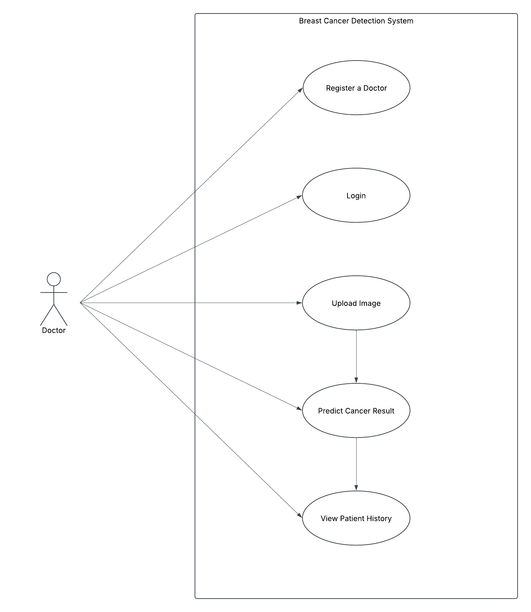
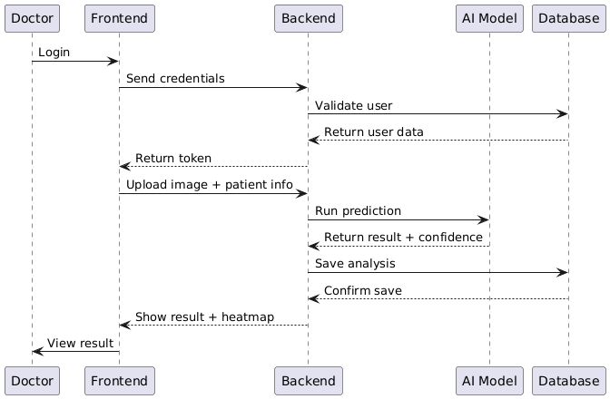
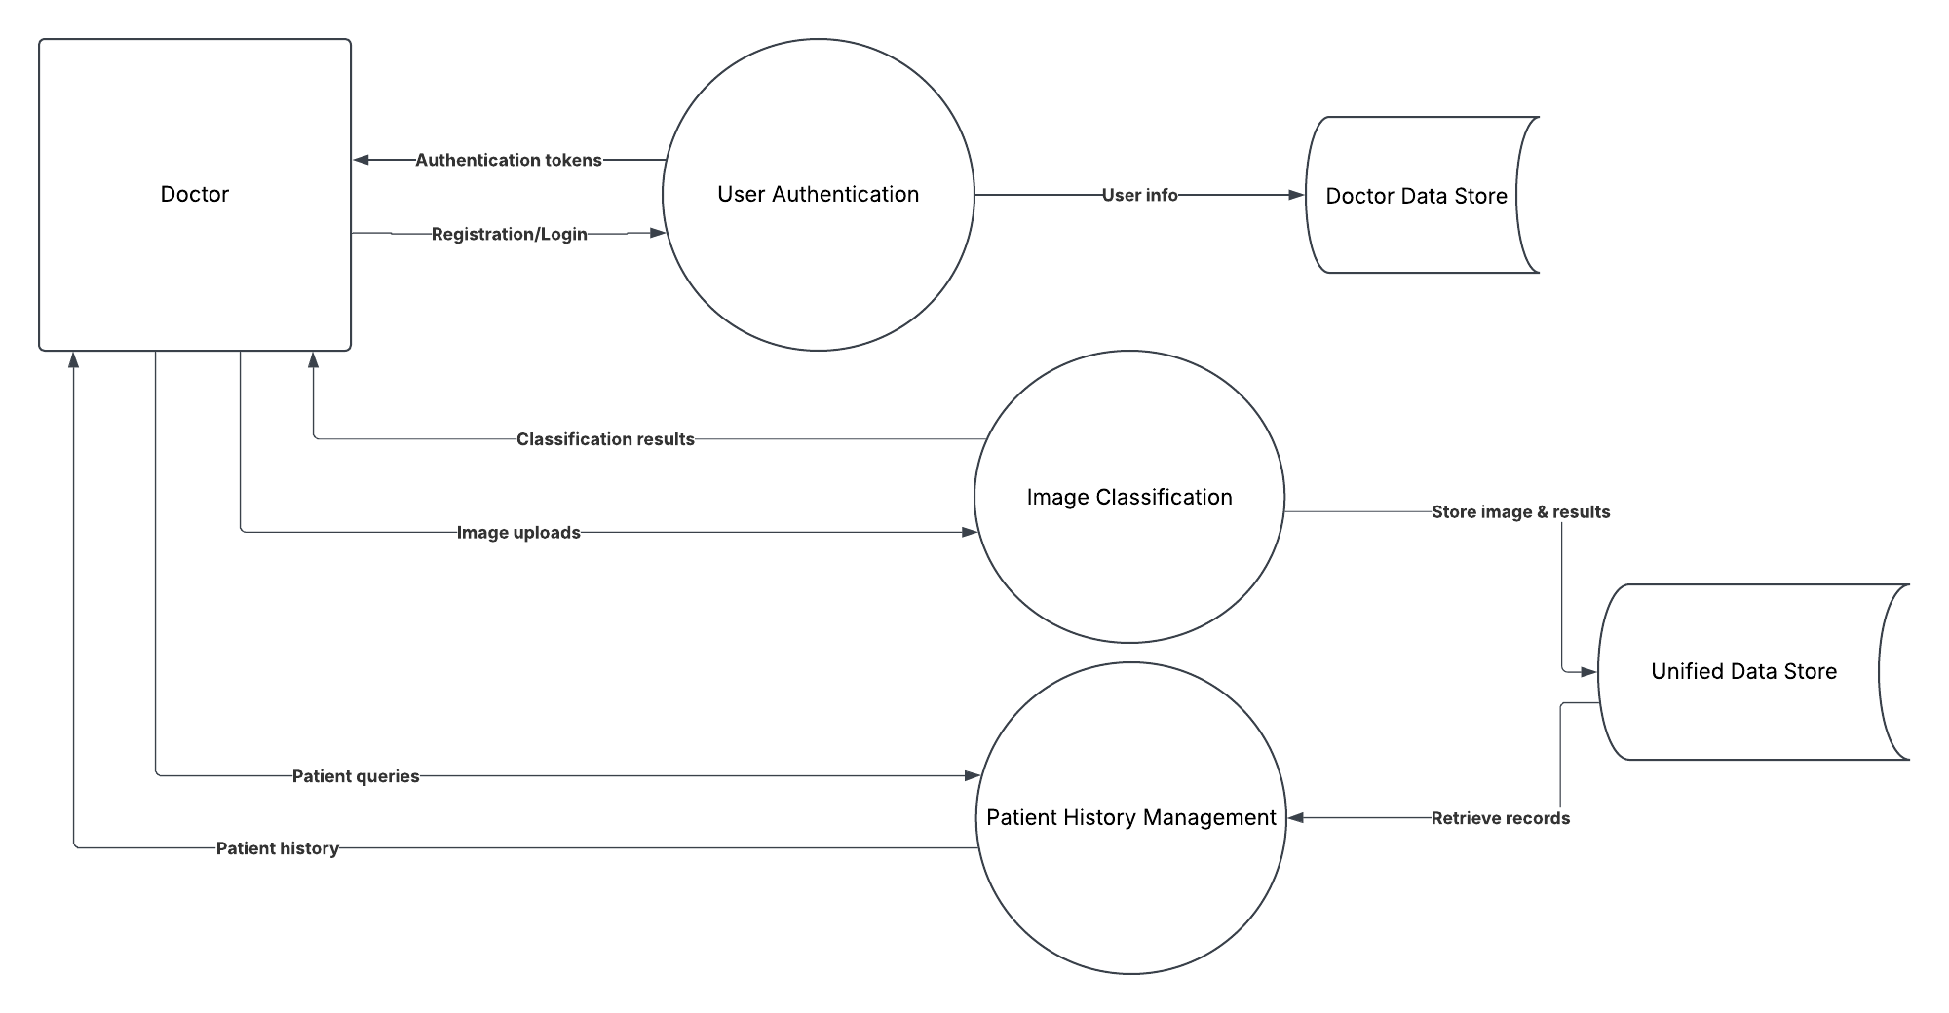
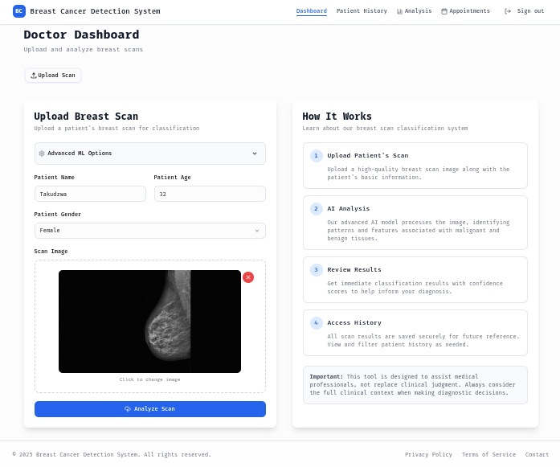
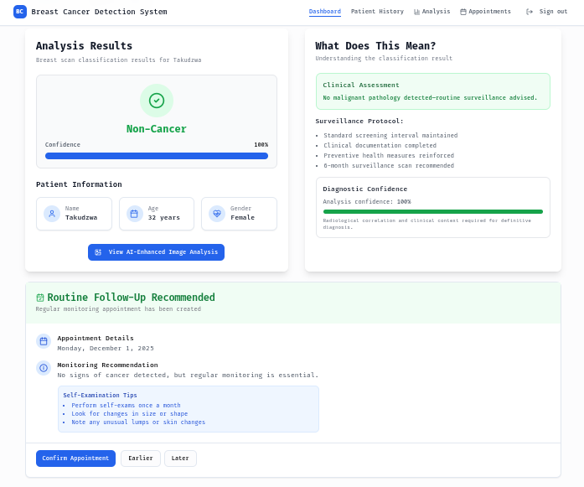
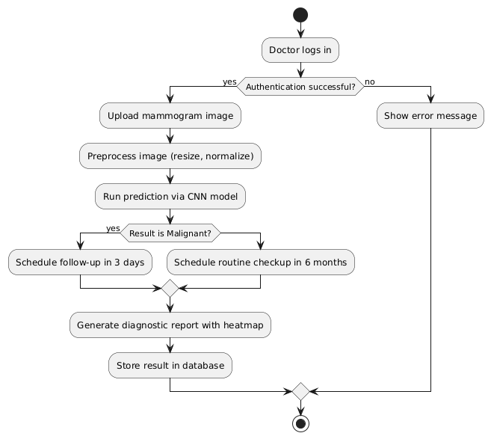
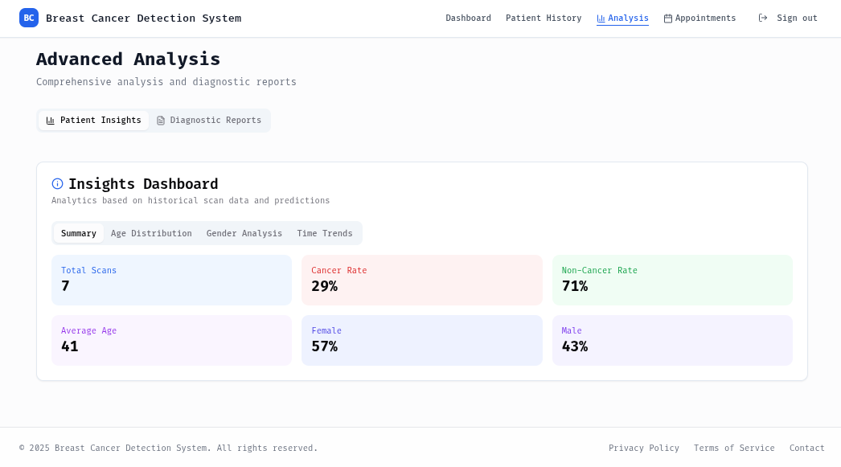
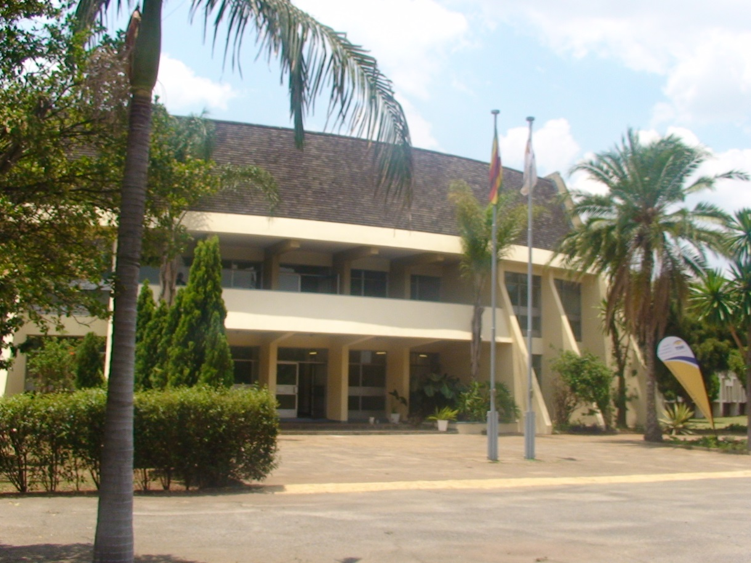
BREAST CANCER DETECTION & MANAGEMENT SYSTEM: AN INTELLIGENT MEDICAL IMAGING SOLUTION USING DEEP LEARNING TECHNOLOGY
^{1,2}Department of Software Engineering, School of information Sciences and Technology, Ganges Rd, Box BE 277,Belvedere,Harare,Zimbabwe
¹ Dexter Mtetwa, ² Mr W Manjoro
h210027f@hit.ac.zw,
Abstract
Use Cases
Conclusion
This paper details the development of an AI-powered Breast Cancer Detection System using a Convolutional Neural Network (CNN) to classify mammography images as cancerous or non-cancerous. The system integrates deep learning with a web application, allowing medical professionals to upload images, receive real-time predictions with confidence scores, and access automated reports. It features intelligent scheduling for follow-up consultations based on results. Designed for resource-limited settings, the system enhances diagnostic accuracy and workflow efficiency while ensuring data security. Future improvements include multi-modal imaging, continuous learning, and explainable AI to further support clinical decision-making.
UML Sequence Diagram
To conclude, this Breast Cancer Detection System marks a significant advancement in diagnostic healthcare by uniting deep learning, secure data handling, and intelligent automation into a seamless, accessible platform. By enabling accurate image classification, streamlining follow-up care, and providing real-time insights through data visualization, it addresses critical challenges in early detection and specialist accessibility—especially in resource-constrained settings. While continuous validation and ethical AI integration remain essential, future innovations such as multi-modal imaging and predictive analytics promise to further personalize care, improve outcomes, and transform breast cancer management worldwide.
Introduction
Future work
Breast cancer poses a global health challenge, with 2.3 million cases diagnosed annually. Resource-limited regions struggle with outdated imaging equipment, limited training, and insufficient screening programs. These barriers hinder early detection and effective diagnosis. Emerging AI technologies, particularly Convolutional Neural Networks, offer promising solutions by enhancing image analysis and diagnostic accuracy. Advances in computing power, medical imaging datasets, and transfer learning now enable practical AI tools that support global efforts to improve diagnostics and extend medical expertise to underserved populations.
The future of the Breast Cancer Detection System includes AI-driven risk stratification, integrating genetic, lifestyle, and biomarker data for personalized screening. Real-time collaboration via telemedicine will connect specialists for faster, more accurate diagnoses. Predictive analytics will guide treatment planning by forecasting responses and outcomes. Integration with advanced screening technologies like breast CT and ultrasound will enhance diagnostic precision. Together, these innovations aim to deliver earlier detection, personalized care, and better outcomes, transforming the system into a comprehensive cancer care solution.
System Overview (Data Flow Diagram)
Results and screenshots
System Dashboard
Problem Statement
References
This Breast Cancer Detection System addresses the gap between rising demand for accurate screening and the limited availability of expert radiologists, especially in resource-constrained settings. Delays in diagnosis and inconsistent interpretations due to uneven expertise and workload pressures can negatively affect patient outcomes. Rural patients often face longer wait times, risking disease progression. Human interpretation variability also undermines diagnostic reliability. This system offers a technological solution to enhance diagnostic accuracy, consistency, and accessibility, supporting healthcare professionals in delivering timely, equitable breast cancer care.
Analysis Results
He, K., Zhang, X., Ren, S., & Sun, J. (2016). Deep residual learning for image recognition. In Proceedings of the IEEE Conference on Computer Vision and Pattern Recognition (pp. 770–778). https://ieeexplore.ieee.org/document/7780459
Ribli, D., Horváth, A., Unger, Z., Pollner, P., & Csabai, I. (2018). Detecting and classifying lesions in mammograms with deep learning. Scientific Reports, 8(1), 4165. https://www.nature.com/articles/s41598-018-22437-z
Lee, R. S., Gimenez, F., Hoogi, A., Miyake, K. K., Gorovoy, M., & Rubin, D. L. (2017). A curated mammography data set for use in computer-aided detection and diagnosis research. Scientific Data, 4, 170177. https://www.nature.com/articles/sdata2017177
Activity Diagram
Objectives
Analytics Page
- To develop and implement a high-accuracy AI system for classifying mammographic images as malignant or benign.
- To create a secure and user-friendly web platform that integrates AI diagnostics into healthcare workflows.
- To implement intelligent appointment scheduling based on diagnostic results for timely follow-up care.
- To track and visualize diagnostic trends and patient demographics using interactive charts.
2025
Harare Institute of Technology
P. O. Box BE 277, Belvedere, Harare
Zimbabwe
\jj

